Slide 1
Exceptional Exceptions
with @LlewellynFalco & @JamesRCounts

Slide 2
Eddie Izzard’s printer
http://youtu.be/k6C_HjWr3Nk?t=3m30s

Slide 3
The route to null evil

Slide 4
11
12
13
14
var a = Router.GetRoute("A");
var b = Router.GetRoute("B");
var c = Router.GetRoute("C");
var result = new Helper(a.From, b.To, c.ViaProxy).Send();
System.NullReferenceException: Object reference not set to an instance of an object.
at ExceptionalExamples.UnitTests.NullRef() in UnitTest1.cs: line 14
What is null?
A) a
B) b
C) c
D) I don’t know

Slide 5
IL_0028: ldloc.1 IL_0029: callvirt instance object ExceptionalExamples.Route::get_To()
Which error message would you prefer?
A) Object reference not set to an instance of an object.
B) Cannot access method “get_To” on a null reference
C) Null reference while executing: Route.To
D) Other

Slide 6
11
12
13
14
var a = Router.GetRoute("A");
var b = Router.GetRoute("B");
var c = Router.GetRoute("C");
var result = new Helper(a.From, b.To, c.ViaProxy).Send();
System.NullReferenceException:
Null reference while executing: Route.To
at ExceptionalExamples.UnitTests.NullRef() in UnitTest1.cs: line 14
What is null?
A) a
B) b
C) c
D) I don’t know

Slide 7
This exception proves the rule…
“Print variable values
in your error messages”
…to give the confused coder some guidance

Slide 8
A heapful of rectangles

Slide 9
58
59
60
61
62
63
64
65
66
67
for (var i = 0; i < 10000; i++)
{
int w = random.Next(this.Width);
int h = random.Next(this.Height);
var start = new Point(0, 0);
var end = new Point(w, h);
var b = new LinearGradientBrush(start, end, Color.Red, Color.Blue);
var rect = new Rectangle(random.Next(Width), random.Next(Height), w, h);
e.Graphics.FillRectangle(b, rect);
}
What went wrong?
A) 10,000 rectangles
B) Brush too big
C) Garbage Collection
D) Other
System.OutOfMemoryException: Out of memory.
at LinearGradientBrush..ctor(Point p1, Point p2, Color c1, Color c2)
at MyForm.OnPaint(PaintEventArgs e) in c:\...\UnitTest1.cs:line 64
at Control.PaintWithErrorHandling(PaintEventArgs e, Int16 layer)
at Control.OnPrint(PaintEventArgs e)

Slide 10
A) new LinearGradientBrush(new Point(0, 0), new Point(w, h), Color.Red, Color.Blue);
B) new LinearGradientBrush(new Rectangle(0, 0, w, h), Color.Red, Color.Blue, 1.0f);
Which error message would you prefer?
A) Out of Memory
B) Rectangle '{X=0,Y=0,Width=189,Height=0}' cannot have a width or height equal to 0.
D) Other

Slide 11
58
59
60
61
62
63
64
65
66
67
for (var i = 0; i < 10000; i++)
{
int w = random.Next(this.Width);
int h = random.Next(this.Height);
var start = new Point(0, 0);
var end = new Point(w, h);
var b = new LinearGradientBrush(start, end, Color.Red, Color.Blue);
var rect = new Rectangle(random.Next(Width), random.Next(Height), w, h);
e.Graphics.FillRectangle(b, rect);
}
What went wrong?
A) 10,000 rectangles
B) Brush too big
C) Garbage Collection
D) Other
Rectangle '{X=0,Y=0,Width=189,Height=0}' cannot have a width or height equal to 0.
at LinearGradientBrush..ctor(Point p1, Point p2, Color c1, Color c2)
at MyForm.OnPaint(PaintEventArgs e) in c:\...\UnitTest1.cs:line 64
at Control.PaintWithErrorHandling(PaintEventArgs e, Int16 layer)
at Control.OnPrint(PaintEventArgs e)
Height is 0

Slide 12
This exception proves the rule…
“If the framework gives you bad exceptions, throw better ones”
…to give the confused coder some guidance

Slide 13
This exception proves the rule…
“Print other variables to provide context”
Rectangle '{X=0,Y=0,Width=189,Height=0}'
…to give the confused coder some guidance

Slide 14
Cast into the (Void)

Slide 15
11
12
13
Component[] from = { new Button(), new Form(), new ToolTip(), };
Component[] to = new Collage().GetMemories();
Array.Copy(from, to, from.Length);
System.InvalidCastException: At least one element in the source array could not be cast down to the destination array type.
at System.Array.Copy(Array s, Array d, Int32 l)
at UnitTests.ArrayCopy() in UnitTest1.cs: line 13
What doesn’t fit?
A) Button
B) Form
C) ToolTip
D) I don’t know

Slide 16
13
Array.Copy(from, to, from.Length);
Which error message would you prefer?
A) 1 element could not be cast to the destination array type.
B) Element could not be cast to <Control>
C) <Form> could not be cast to destination array type <Control>
D) Other

Slide 17
11
12
13
Component[] from = { new Button(), new Form(), new ToolTip(), };
Component[] to = new Collage().GetMemories();
Array.Copy(from, to, from.Length);
System.InvalidCastException: <Form> could not be cast to destination array type <Control>
at System.Array.Copy(Array s, Array d, Int32 l)
at UnitTests.ArrayCopy() in UnitTest1.cs: line 13
What doesn’t fit?
A) Button
B) Form
C) ToolTip
D) I don’t know

Slide 18
This exception proves the rule…
“Runtime details make it clear where the error comes from”
…to give the confused coder some guidance

Slide 19
A date with a parser

Slide 20
75
var dateTime = DateTime.Parse(form.Date);
System.FormatException: The string was not recognized as a valid DateTime. There is an unknown word starting at index 7.
at System.DateTimeParse.Parse(String s, DateTimeFormatInfo dtfi, DateTimeStyles styles)
at System.DateTime.Parse(String s)
at ExceptionalExamples.UnitTests.DateTimeParse() in UnitTest1.cs: line 75
How do you need to sanitize the date?
A) Include CultureInfo
B) Remove “th”
C) Only use first three letters of the month
D) Other

Slide 21
75
var dateTime = DateTime.Parse(form.Date);
Which error message would you prefer?
A) Cannot parse "March 6th 2010" at index 7.
B) Cannot parse "March 6th 2010" at index 7.
See http://msdn.go/DateParseHelp for more details
C) Cannot parse "March 6th 2010“ at index 7
Valid formats include:
"<Month> <Day> <Year>" => “January 14 2010”
"<Month>/<Day>/<Year>" => “1/14/2010”
"<Year>-<Month>-<Day>" => “2010-01-24”
D) Other

Slide 22
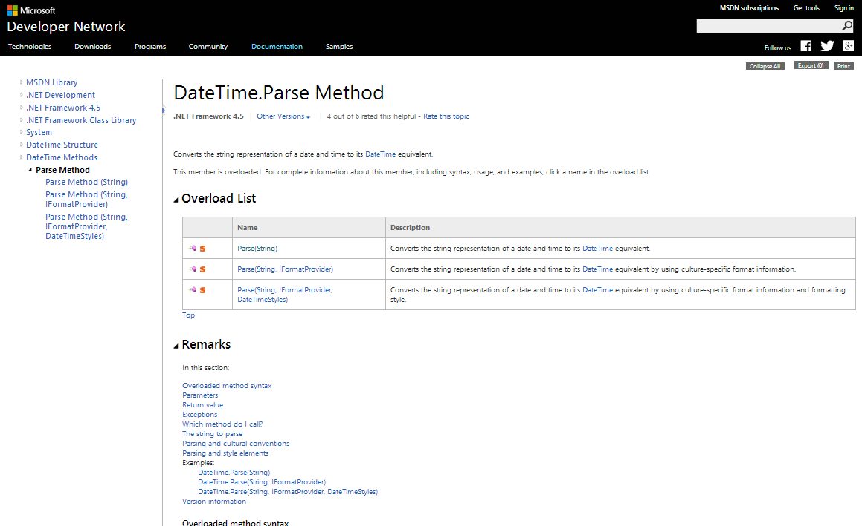

Slide 23
75
var dateTime = DateTime.Parse(form.Date);
System.FormatException: Cannot parse "March 6th 2010" at index 7
Valid formats include:
"<Month> <Day> <Year>" => "January 14 2010"
"<Month>/<Day>/<Year>" => "1/14/2010"
"<Year>-<Month>-<Day>" => "2010-01-24"
at System.DateTimeParse.Parse(String s, DateTimeFormatInfo dtfi, DateTimeStyles styles)
at System.DateTime.Parse(String s)
at ExceptionalExamples.UnitTests.DateTimeParse() in UnitTest1.cs: line 75
How do you need to sanitize the date?
A) Include CultureInfo
B) Remove “th”
C) Only us first three letters of the month
D) Other

Slide 24
This exception proves the rule…
“Show tl;dr examples if
particular formats are required”
…to give the confused coder some guidance

Slide 25
Touching your privates in public

Slide 26
82
83
84
85
86
var su = new SignUpPrompt();
su.Advertise();
var pb = new PrivateObject(su.BuyButton, new PrivateType(typeof(ButtonBase)));
var isAnimating = (bool)pb.Invoke("GetFlag", new[] { 0x0010 });
Assert.IsTrue(isAnimating);
private bool GetFlag(int flag)
What went wrong?
A) Not on ButtonBase
B) Wrong parameters
C) Docs are out of date
D) Other
System.MissingMethodException:
Method 'System.Windows.Forms.ButtonBase.GetFlag' not found.
at System.RuntimeType.InvokeMember(String name, BindingFlags bindingFlags, …)
at ExceptionalExamples.UnitTests.ButtonAnimation() in UnitTest1.cs: line 85

Slide 27
85
var isAnimating = (bool)pb.Invoke("GetFlag", new[] { 0x0010 });
Which error messages are helpful?
A) Cannot find method: GetFlag(int[])
B) Possible methods starting with “G” are:
GetFlag(int)
GetPreferedSizeCore(Size)
C) Common Fixes
If method not listed it might be on a base class
i.e. new PrivateObject(o, new PrivateType(typeof(BaseClass)))
If method is listed check your parameter list
i.e. p.Invoke(“MethodName”, param1, param2)
D) All of the above

Slide 28
82
83
84
85
86
var su = new SignUpPrompt();
su.Advertise();
var pb = new PrivateObject(su.BuyButton, new PrivateType(typeof(ButtonBase)));
var isAnimating = (bool)pb.Invoke("GetFlag", new[] { 0x0010 });
Assert.IsTrue(isAnimating);
System.MissingMethodException:
Cannot find method: GetFlag(int[]).
Possible methods starting with “G” are:
GetFlag(int)
GetPreferedSizeCore(Size)
Common Fixes
If method not listed it might be on a base class
i.e. new PrivateObject(o, new PrivateType(typeof(BaseClass)))
If method is listed check your parameter list
i.e. p.Invoke(“MethodName”, param1, param2)
at System.RuntimeType.InvokeMember(String name, BindingFlags bindingFlags, …)
at ExceptionalExamples.UnitTests.ButtonAnimation() in UnitTest1.cs: line 85
What went wrong?
A) Not on ButtonBase
B) Wrong parameters
C) Docs are out of date
D) Other

Slide 29
This exception proves the rule…
“Don’t hold back,
You don’t know which clue will help”
…to give the confused coder some guidance

Slide 30
82
83
84
85
86
var su = new SignUpPrompt();
su.Advertise();
var pb = new PrivateObject(su.BuyButton));
var isAnimating = (bool)pb.Invoke("GetFlag", 0x0010);
Assert.IsTrue(isAnimating);
System.MissingMethodException:
Cannot find method: GetFlag(int).
Possible methods starting with “G” are:
<none>
Common Fixes
If method not listed it might be on a base class
i.e. new PrivateObject(o, new PrivateType(typeof(BaseClass)))
If method is listed check your parameter list
i.e. p.Invoke(“MethodName”, param1, param2)
at System.RuntimeType.InvokeMember(String name, BindingFlags bindingFlags, …)
at ExceptionalExamples.UnitTests.ButtonAnimation() in UnitTest1.cs: line 85
What went wrong?
A) Not on Button
B) Wrong parameters
C) Docs are out of date
D) Other

Slide 31
Don’t disturb the natives
…or Dynamically Lost Library

Slide 32
82
...
100
101
NativeDll.svn_client_info();
[DllImport("libsvn_client-1-0.dll")]
public static extern int svn_client_info();
06/25/2014 09:59 PM 10,240 ExceptionalExamples.dll
06/03/2014 06:11 AM 255,849 libsvn_client-1-0.dll
2 File(s) 266,089 bytes
Why can’t we find the DLL?
A) Wrong File Permissions
B) Wrong Working Directory
C) Wrong Processor Arch
D) Other
System.DllNotFoundException:
Unable to load DLL 'libsvn_client-1-0.dll':
The specified module could not be found.
(Exception from HRESULT: 0x8007007E)
at ExceptionalExamples.NativeDll.svn_client_info()
at ExceptionalExamples.UnitTests.NativeTest() in UnitTest1.cs: line 82

Slide 33
100
[DllImport("libsvn_client-1-0.dll")]
Which error messages are helpful?
A) Problems loading dependencies for “libsvn_client-1-0.dll”.
B) Could not find dependency: “MSYS-1.0.dll”
C) Required libraries:
MSYS-1.0.dll
LIBSVN_DELTA-1-0.DLL
LIBSVN_DIFF-1-0.DLL
LIBAPR-0-0.DLL
LIBSVN_SUBR-1-0.DLL
D) All of the above

Slide 34
82
...
100
101
NativeDll.svn_client_info();
[DllImport("libsvn_client-1-0.dll")]
public static extern int svn_client_info();
06/25/2014 09:59 PM 10,240 ExceptionalExamples.dll
06/03/2014 06:11 AM 255,849 libsvn_client-1-0.dll
2 File(s) 266,089 bytes
System.DllNotFoundException:
Problems loading dependencies for “libsvn_client-1-0.dll”.
Could not find dependency: “MSYS-1.0.dll”
Required libraries:
MSYS-1.0.dll
LIBSVN_DELTA-1-0.DLL
LIBSVN_DIFF-1-0.DLL
LIBAPR-0-0.DLL
LIBSVN_SUBR-1-0.DLL
at ExceptionalExamples.NativeDll.svn_client_info()
at ExceptionalExamples.UnitTests.NativeTest() in UnitTest1.cs: line 82
Why can’t we find the DLL?
A) Wrong File Permissions
B) Wrong Working Directory
C) Wrong Processor Arch
D) Other

Slide 35
This exception proves the rule…
“Highlight root causes”
…to give the confused coder some guidance

Slide 36
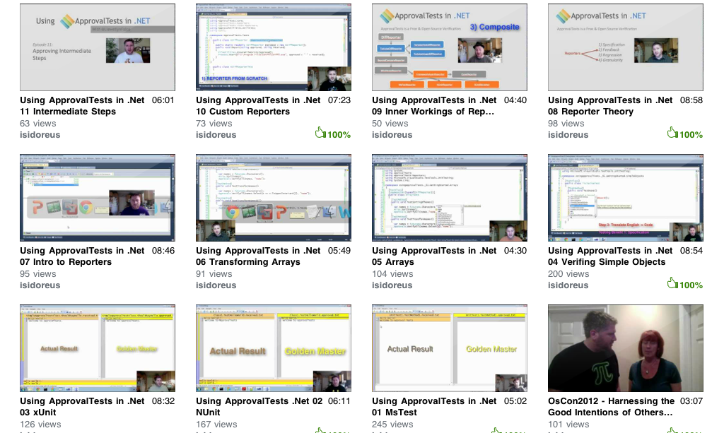
Approval Tests
20 episode youtube series

Slide 37


Slide 38
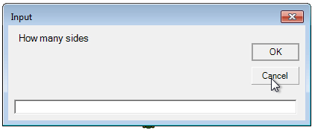


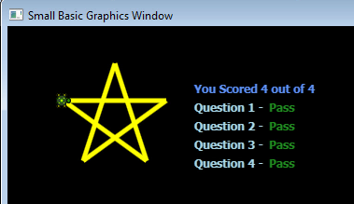
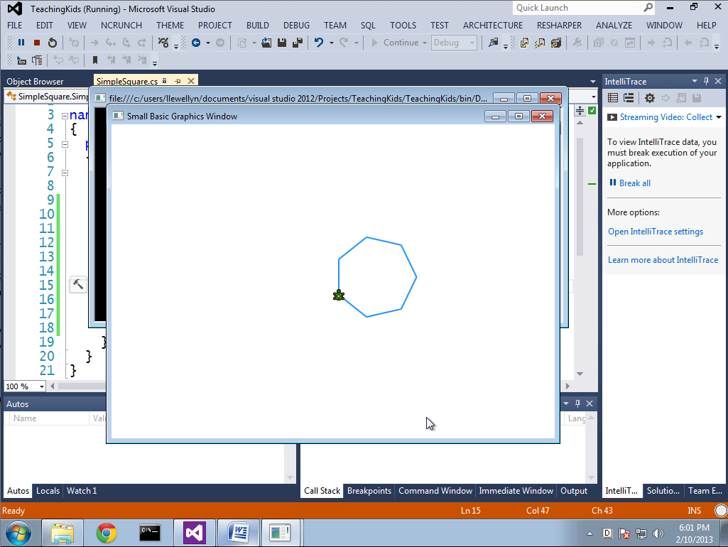
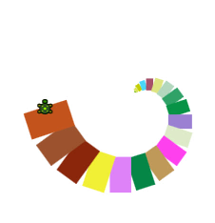
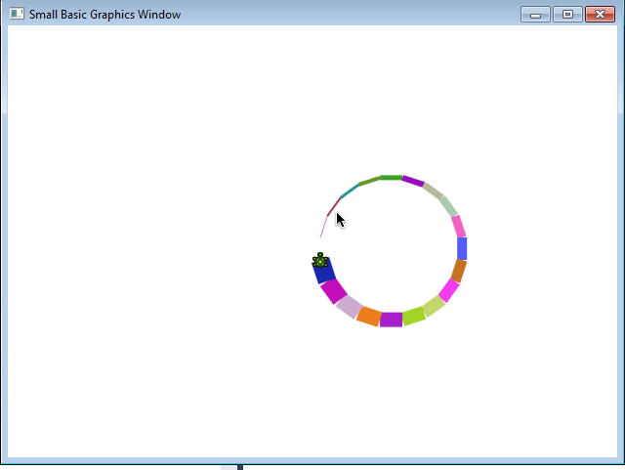
pluralsight.com/kids

Slide 39


Contact Information
Slides at http://lfal.co/ExceptionalExceptions
@JamesRCounts
http://IHadThisIdeaOnce.com
@LlewellynFalco http://LlewellynFalco.Blogspot.com

Slide 40
This exception proves the rule…
“Give example code
for any setup needed”
…to give the confused coder some guidance

Slide 41
This exception proves the rule…
“Point to online documentation”
…to give the confused coder some guidance

